Slide 1
Root directory of virtual environment
The virtual environment of python Django web site
0
C:\venvs
1
python -m venv mysite
2
C:\venvs\mysite\Scripts\activate.bat
Get into “virtual environment. Then install Django
TEST: Web site running without app creation
At this point, you can open them with editor such as pycharm, vscode etc. NOTE: do not forget to set “virtual environment” of python on your ide
python manage.py runserver
virtual environment
Virtual Environment
3
Pip install django
Confirm: pip freeze: compare
Folder “projects/mysite/appName” will be created via…
Django site creation
Main Web Project
5
Web Site
Create Project folder: “projects/mysite”
Run Django site
7
6
App
App
django-admin startproject config .
App
django-admin startapp appName
8
Config/urls.py
9
python manage.py runserver
Config/settings.py
Run it on browser
Get into “virtual environment.
4
project
Project folder: “projects”
10
http://localhost:8000/appName
NOTE: Under project folder, get into “virtual” environment. Then do process #5. #5 can be skipped and “Django-admin startproject”, but it generates folder a bit weird.
INSTALLED_APPS section: Register App you have created on #7 process

Slide 2
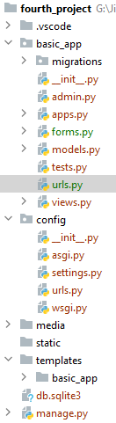
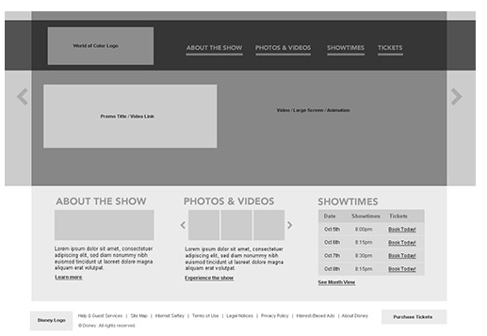
0
Python Django Web Project and App Structure
Settings
$ python manage.py --help
Type 'manage.py help <subcommand>' for help on a specific subcommand.
Available subcommands:
[auth]
changepassword
createsuperuser
[contenttypes]
remove_stale_contenttypes
[django]
check
compilemessages
createcachetable
dbshell
diffsettings
dumpdata
flush
inspectdb
loaddata
makemessages
makemigrations
migrate
sendtestemail
shell
showmigrations
sqlflush
sqlmigrate
sqlsequencereset
squashmigrations
startapp
startproject
test
testserver
[sessions]
clearsessions
[staticfiles]
collectstatic
findstatic
runserver
Web Project
1
Web project
Web Project Routing
App
ORM
App
2
App
App Routing
app
admin
6
Built-In Authentication
form
MTV Pattern
model
3
DB
view
4-2
App routing
Controller
view
Form
4-1
4
5
html
5-1
Settings
model
template html
Web project routing
static
Css, Js, Image, etc
data
presentation
static
Template html
User Defined Data
ORM: Code First
DB
Python command
python manage.py makemigrations
python manage.py migrate
Ref: https://docs.djangoproject.com/en/3.0/ref/models/fields/#field-types
Ref: https://docs.djangoproject.com/en/3.0/topics/db/queries/
Ref: https://docs.djangoproject.com/en/3.0/topics/templates/
Ref: https://docs.djangoproject.com/en/3.0/topics/forms/

